Slide 1
Intermediary Presentation
Year Project
By Ross Walker Burke
C00249184

Slide 2

Structure
The project
Work done
Work to be done
Art elements
Design elements
Programming elements
Questions
Resources, Tools, and Equipment

Slide 3
The Project
To Concept, Create, Design, animate and Programme a 3D Character and its interactable space.
To create a presentable piece of interactable animated 3D Character.
Uses python.
The finished piece can be used in a Cartoon/ animated medium or a video game medium.

Slide 4
Work done
Concepted and designed a character for smooth low poly.
Made a character background
Began designs on how my project implements programming and design parts to the project.
Researching programme libraries of python as well as watching and researching videos.
Just began 3D modelling of the character and its environment.
Key frames/ started storyboarding animation
Plans made of how I want the piece to be interactable and displayed
Work on documents in the area of the project.

Slide 5
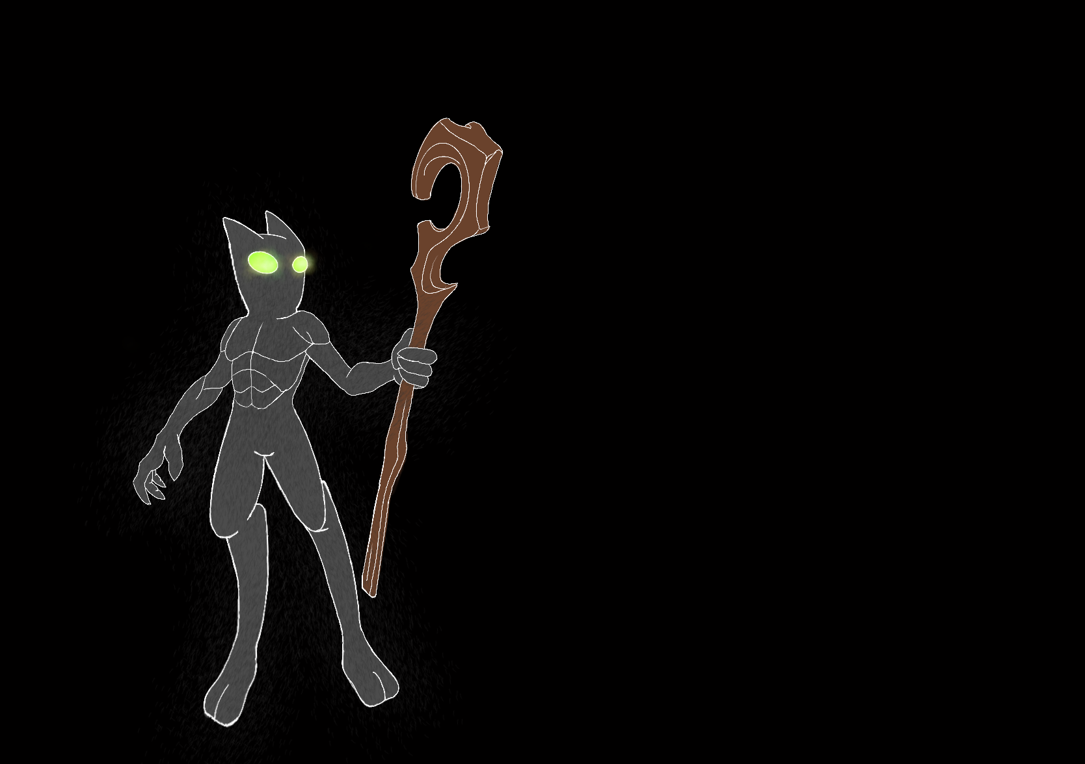
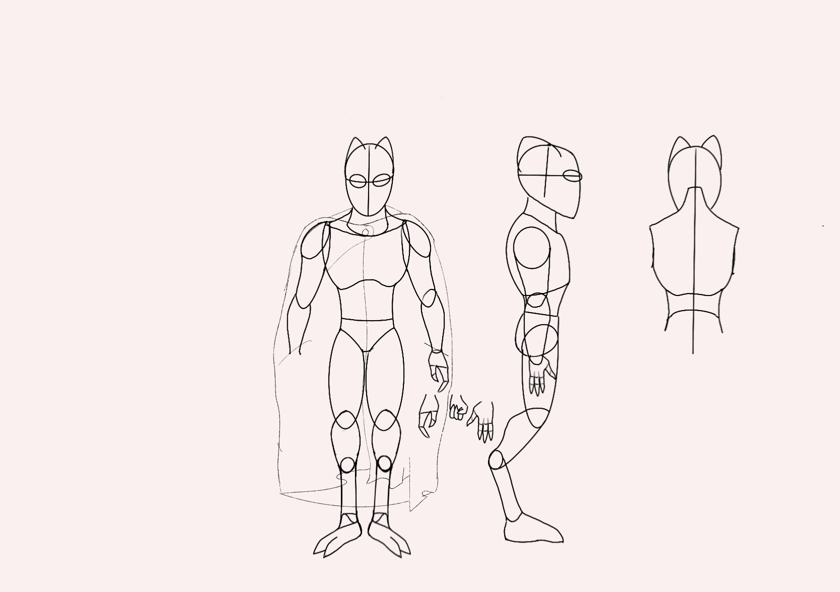
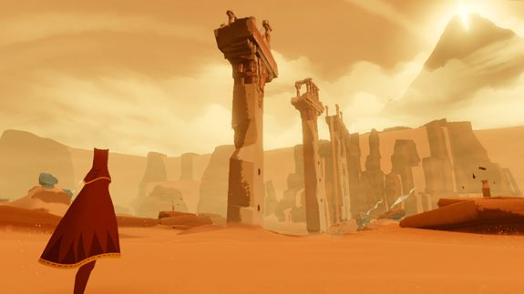
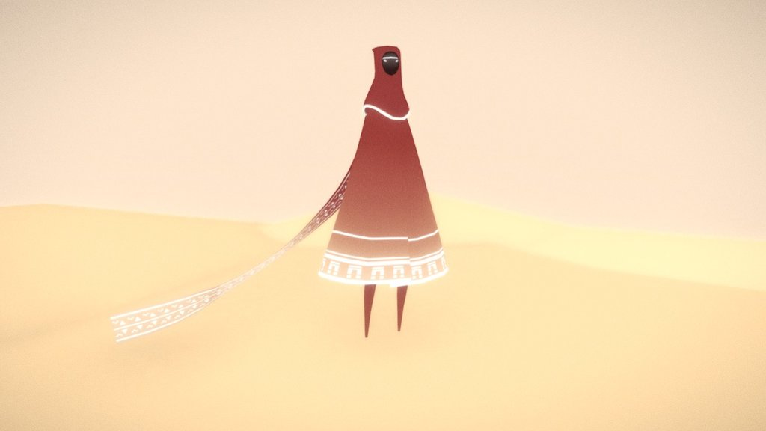
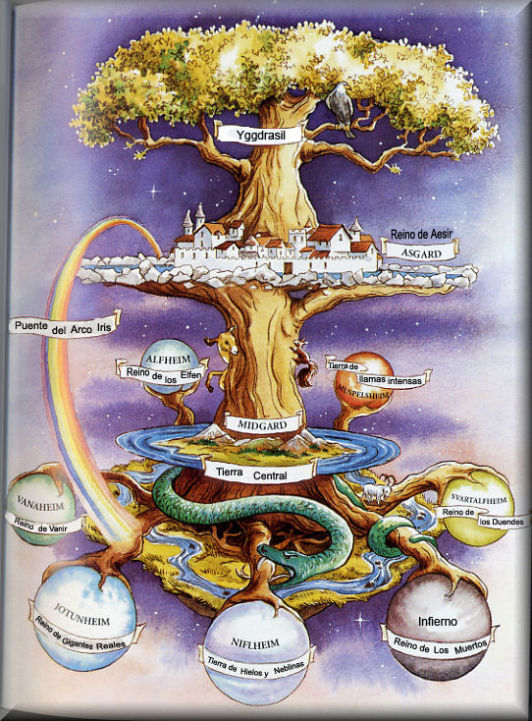
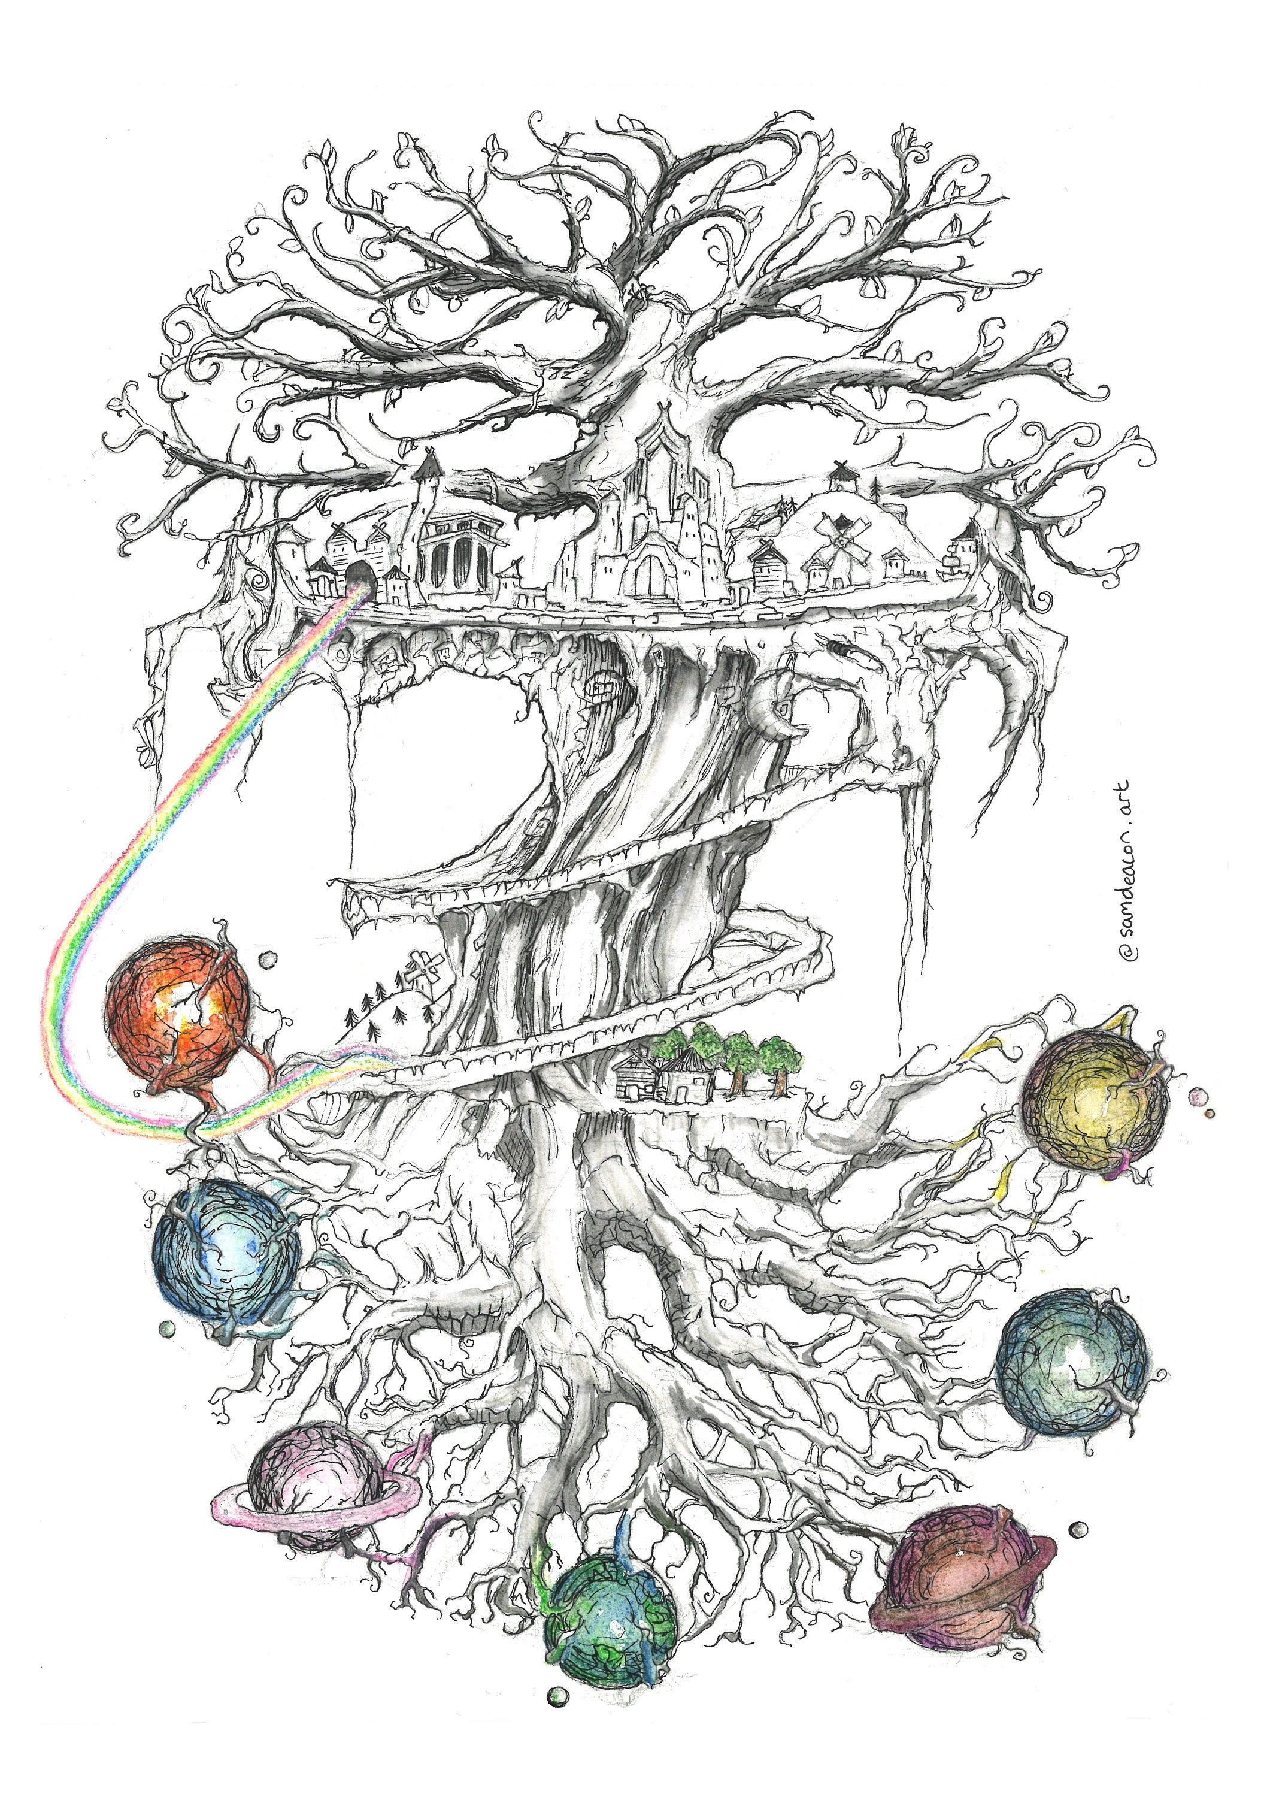
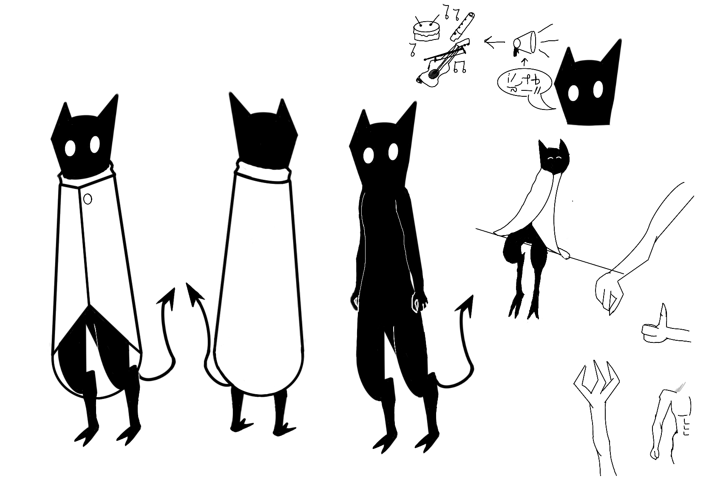

Slide 6
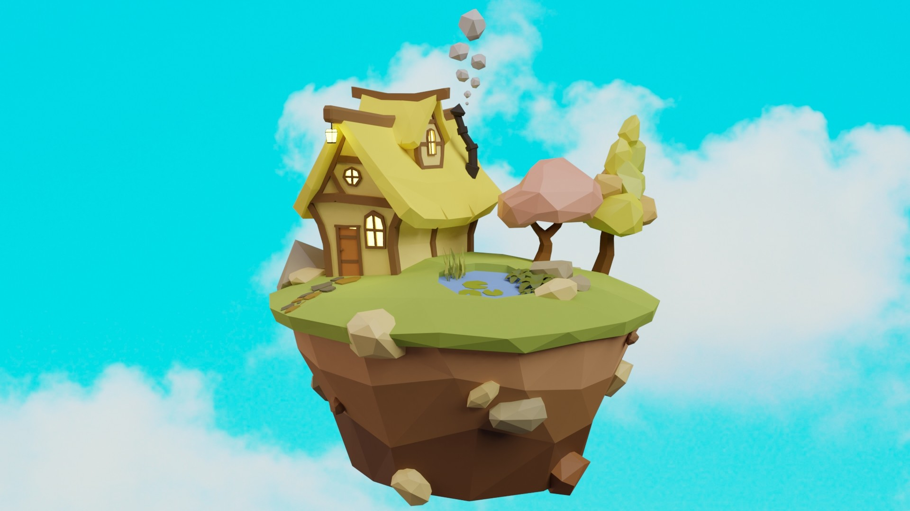
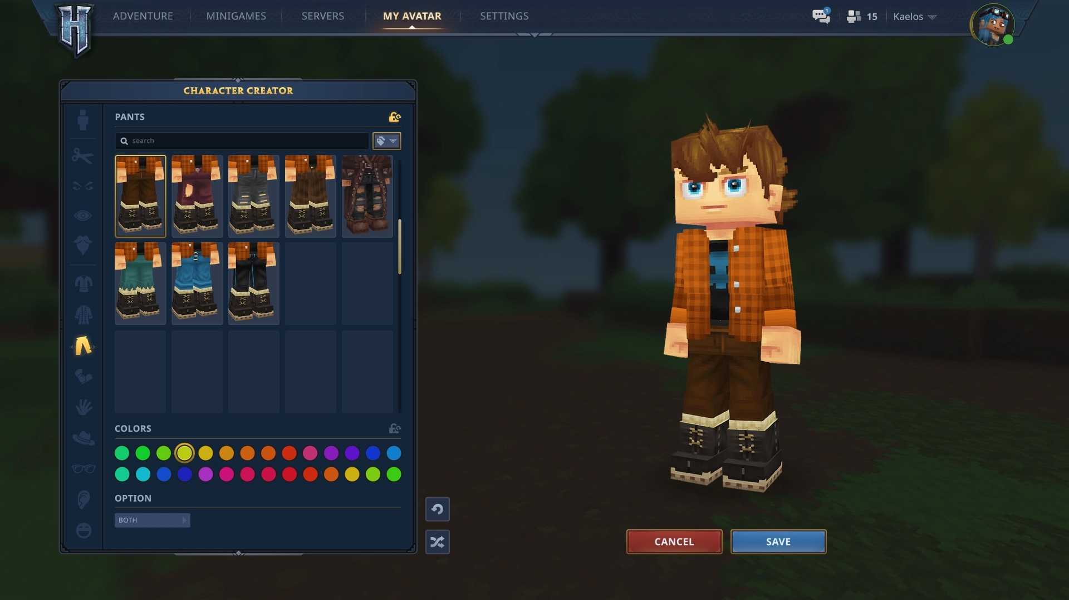
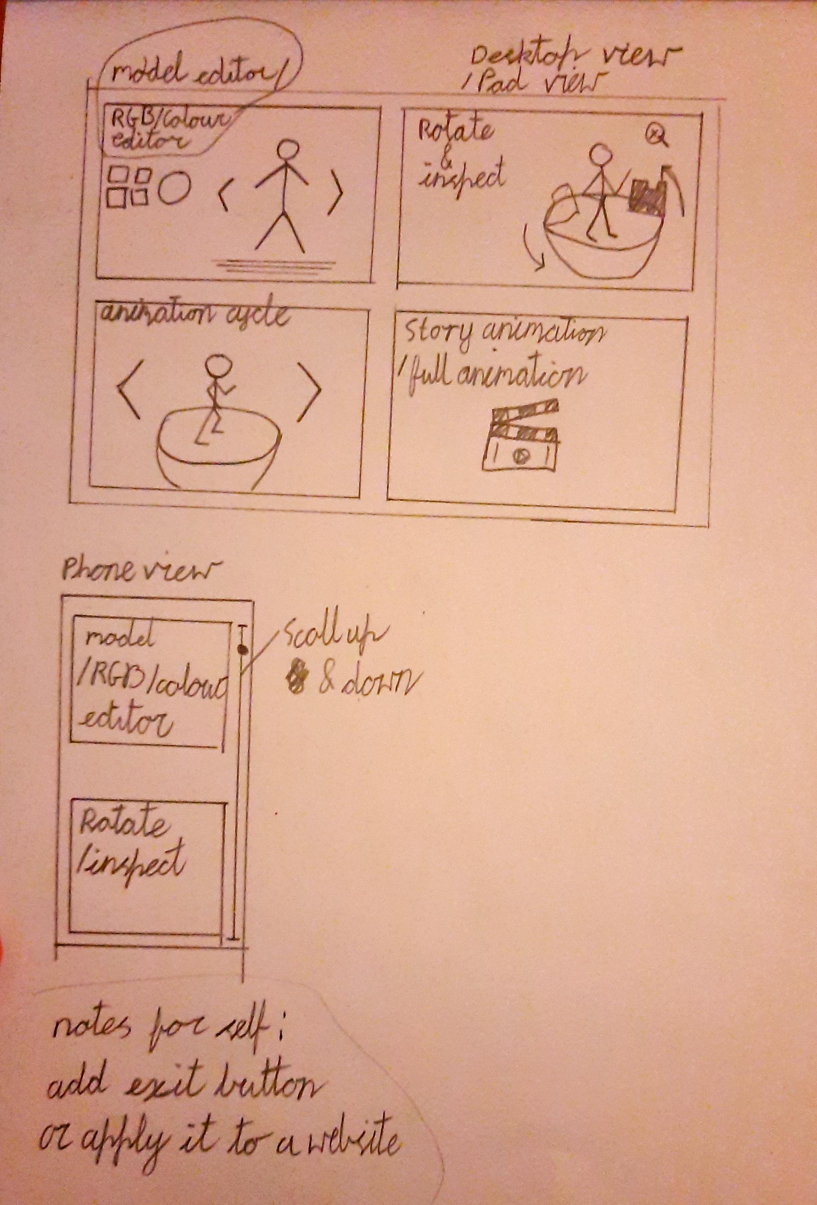
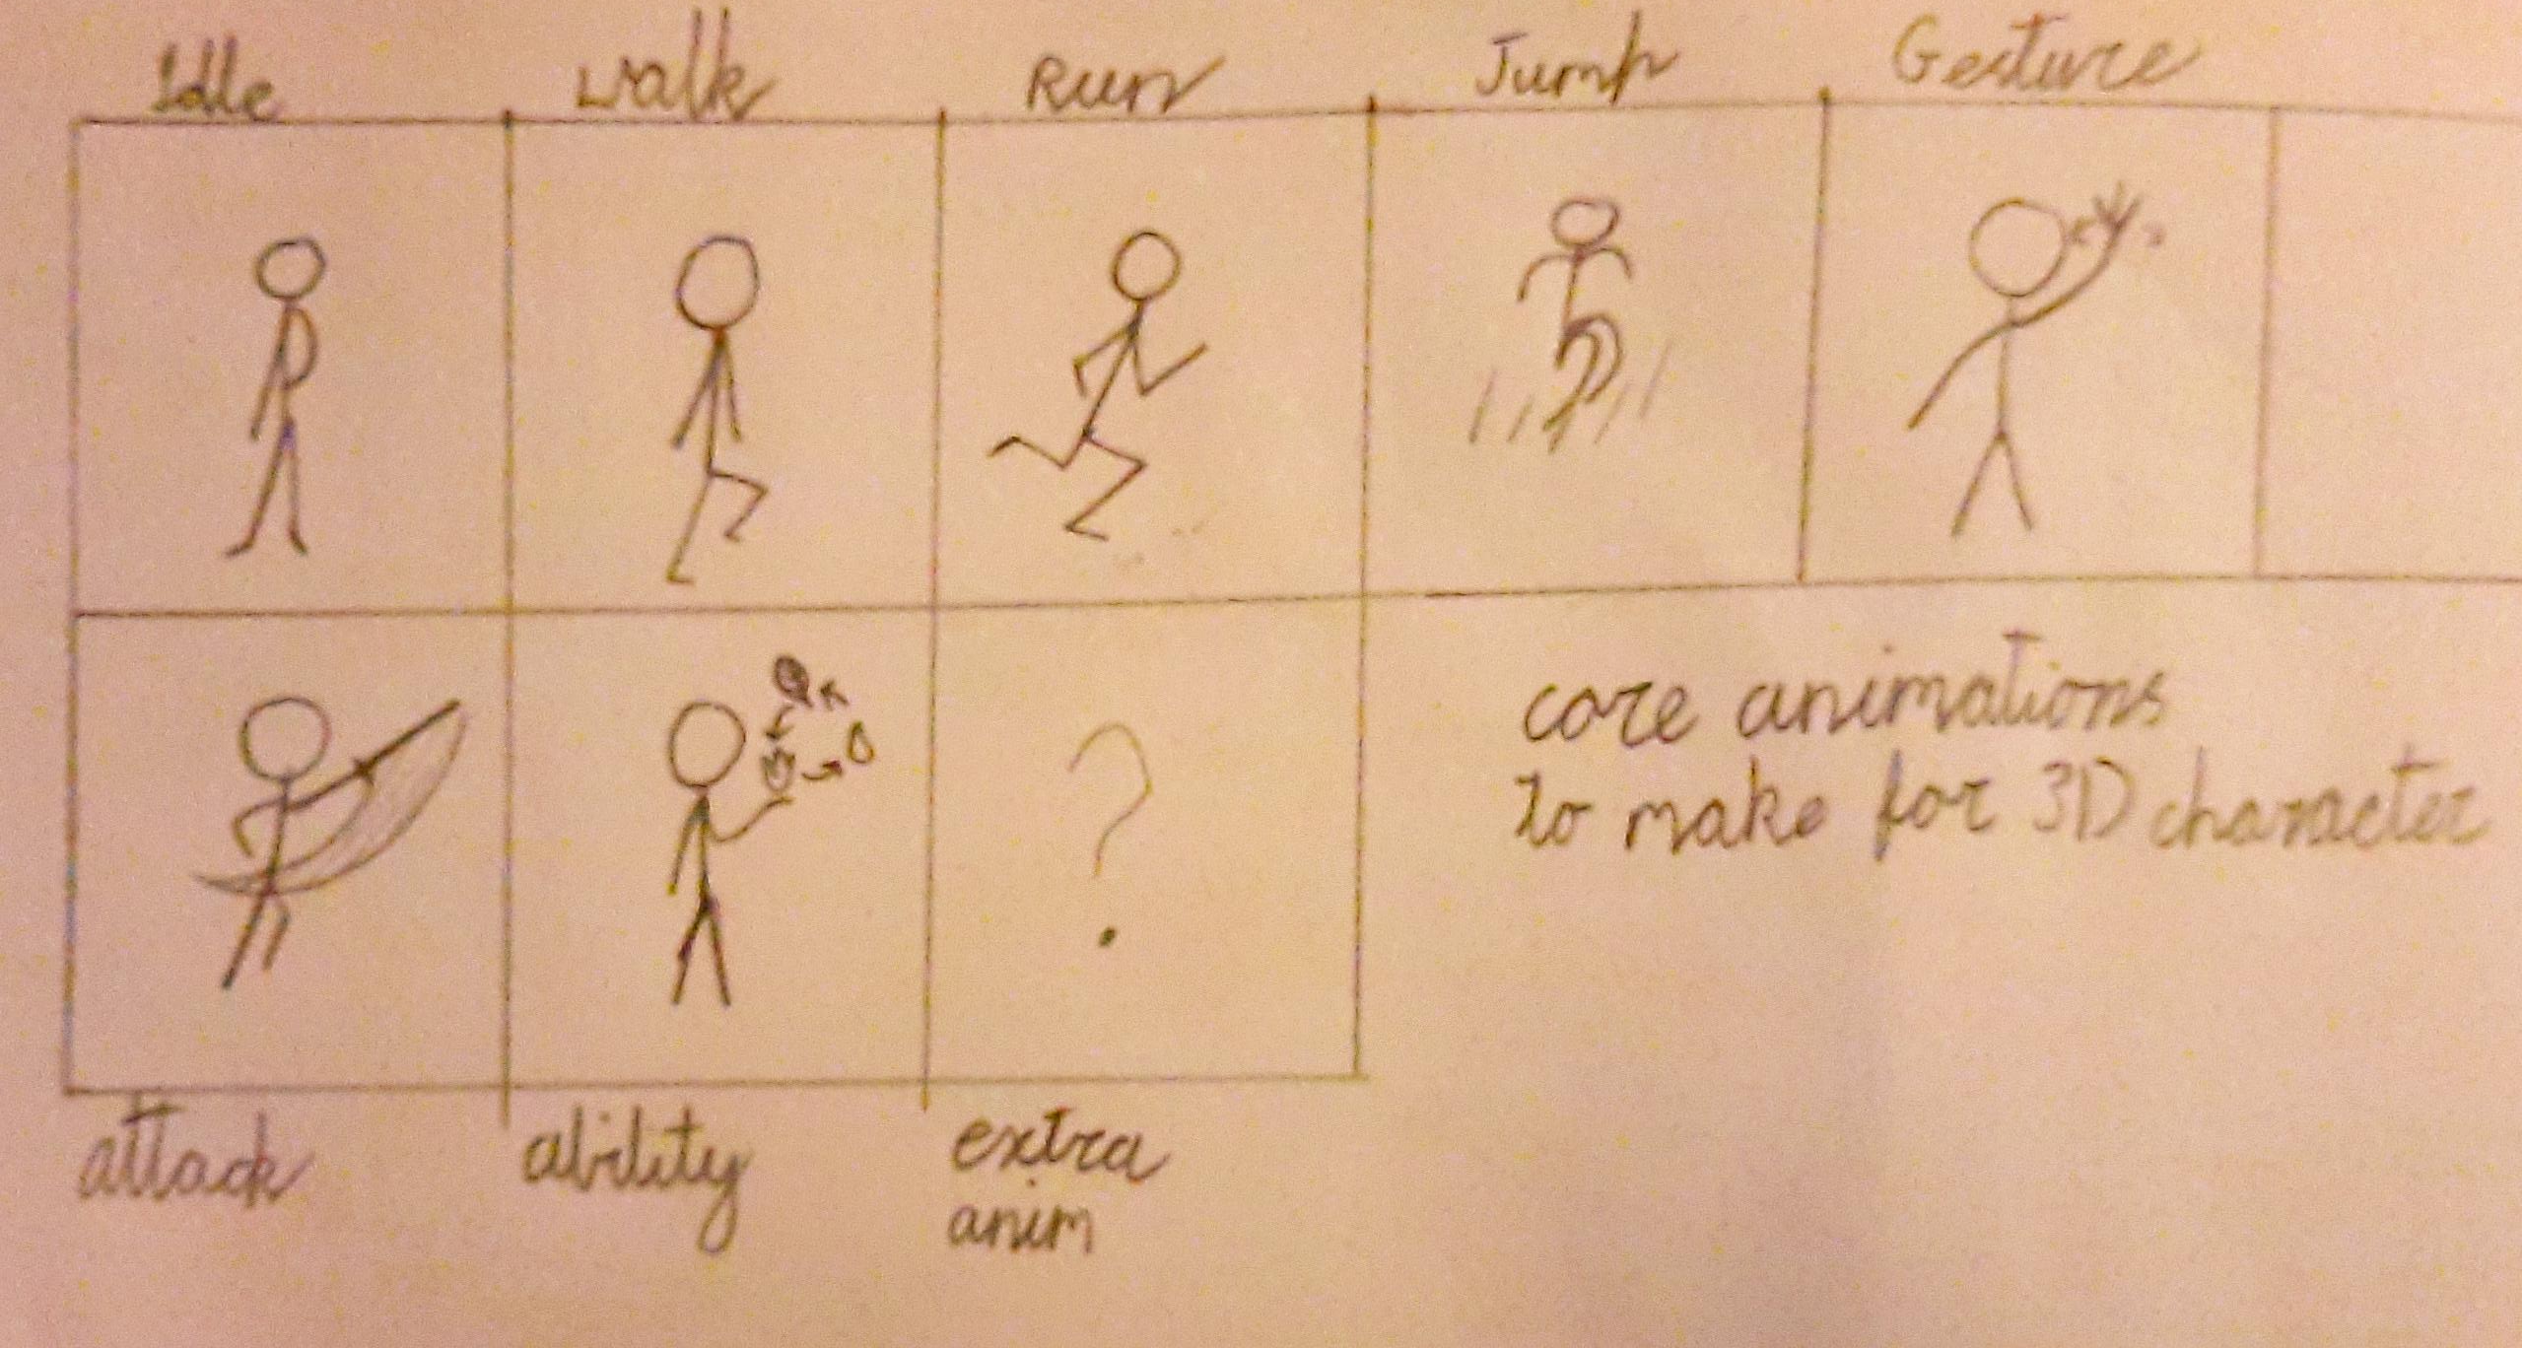
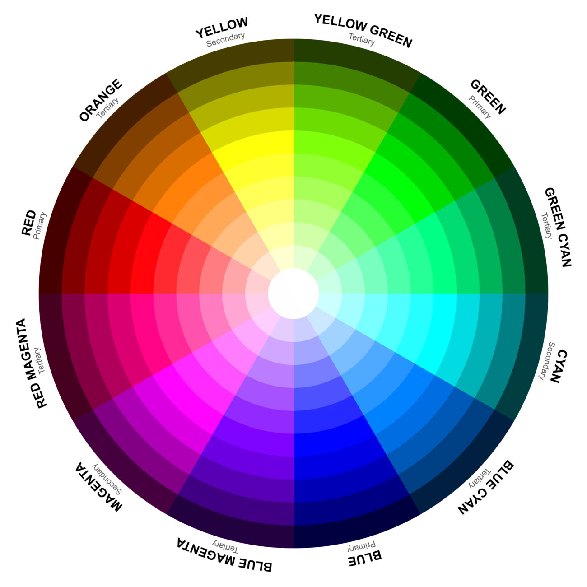

Slide 7
Work to be done
Deciding if a downloadable app or a website is best to present the project.
Programme and input designs to the app or website
Get more python library work done
Create and texture the 3D Character
Animate the 3D Character
Find tools to be used to design the app or website. (e.g. WordPress)
Continue work diary
Continue Work on and clean up documents

Slide 8
Resources, Tools, and Equipment
“It’s better to have and not need, than a need but not have “
Art – Maya, Z brush, Blender, Procreate, Photoshop, Substance
Programming – python, visual studio code
Design – illustrator, Balsamiq, Invision
Presentation equipment- keyboard and mouse, Large screen or monitor, audio outputs and a pc

Slide 9
Art elements
Concept character
Concept environment
Prepare drawings
3D model character
3D model environment
texture
animate

Slide 10
Design elements
Design character
Design and create a story of the world of the character
Design how it will be presented
Design how it will be interactable
Design a storyboard for the animation
Design how the app or website will work

Slide 11
Programming elements
Use a python library for programming
Programme visual effects used in animation
Programme interactions the interactions of the presentable endpiece
Programme the app or website.
Programme a way to select parts of the finished character to change RGB values

Slide 12
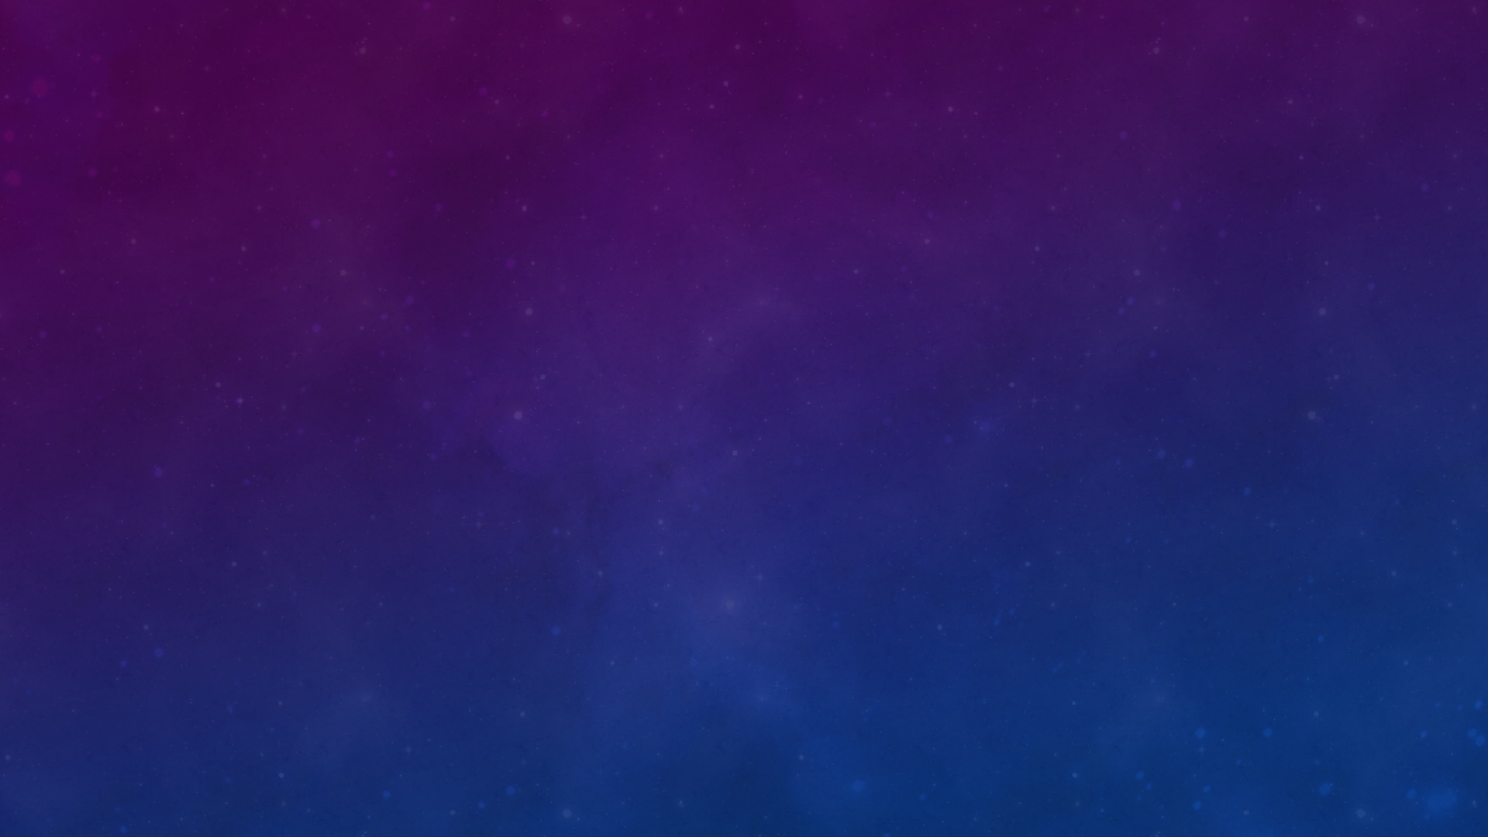

Questions
Any question

